Slide 1
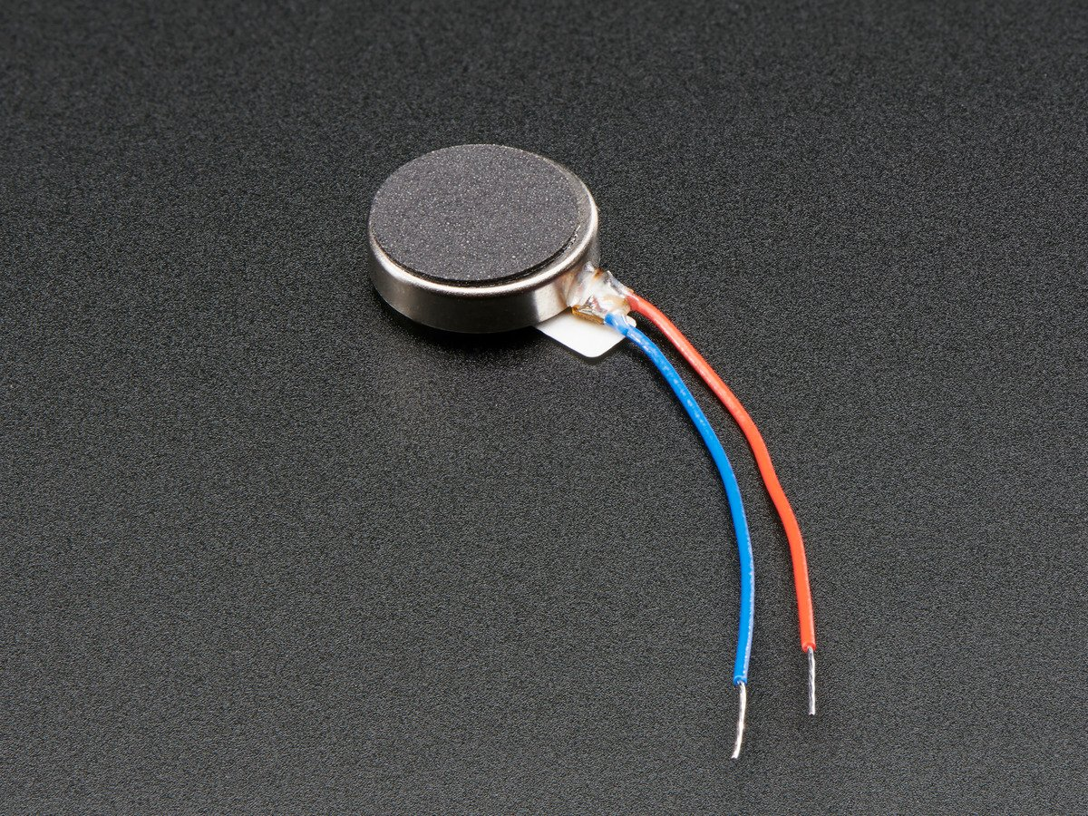
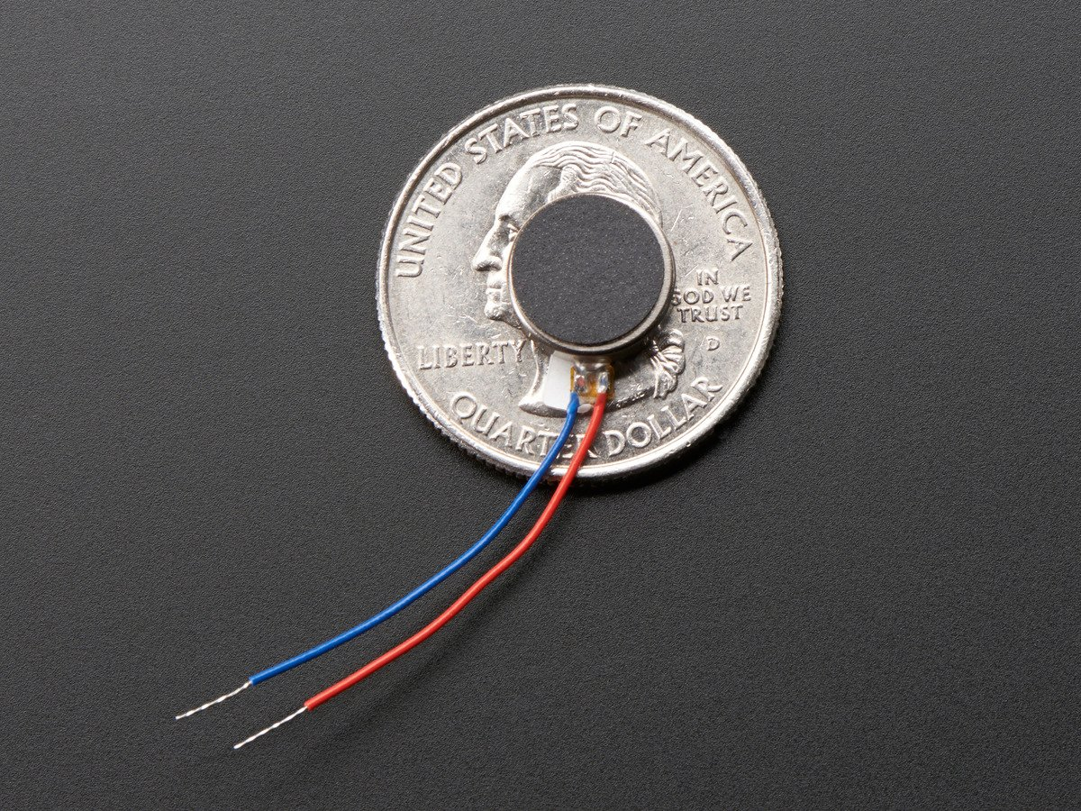

Slide 2
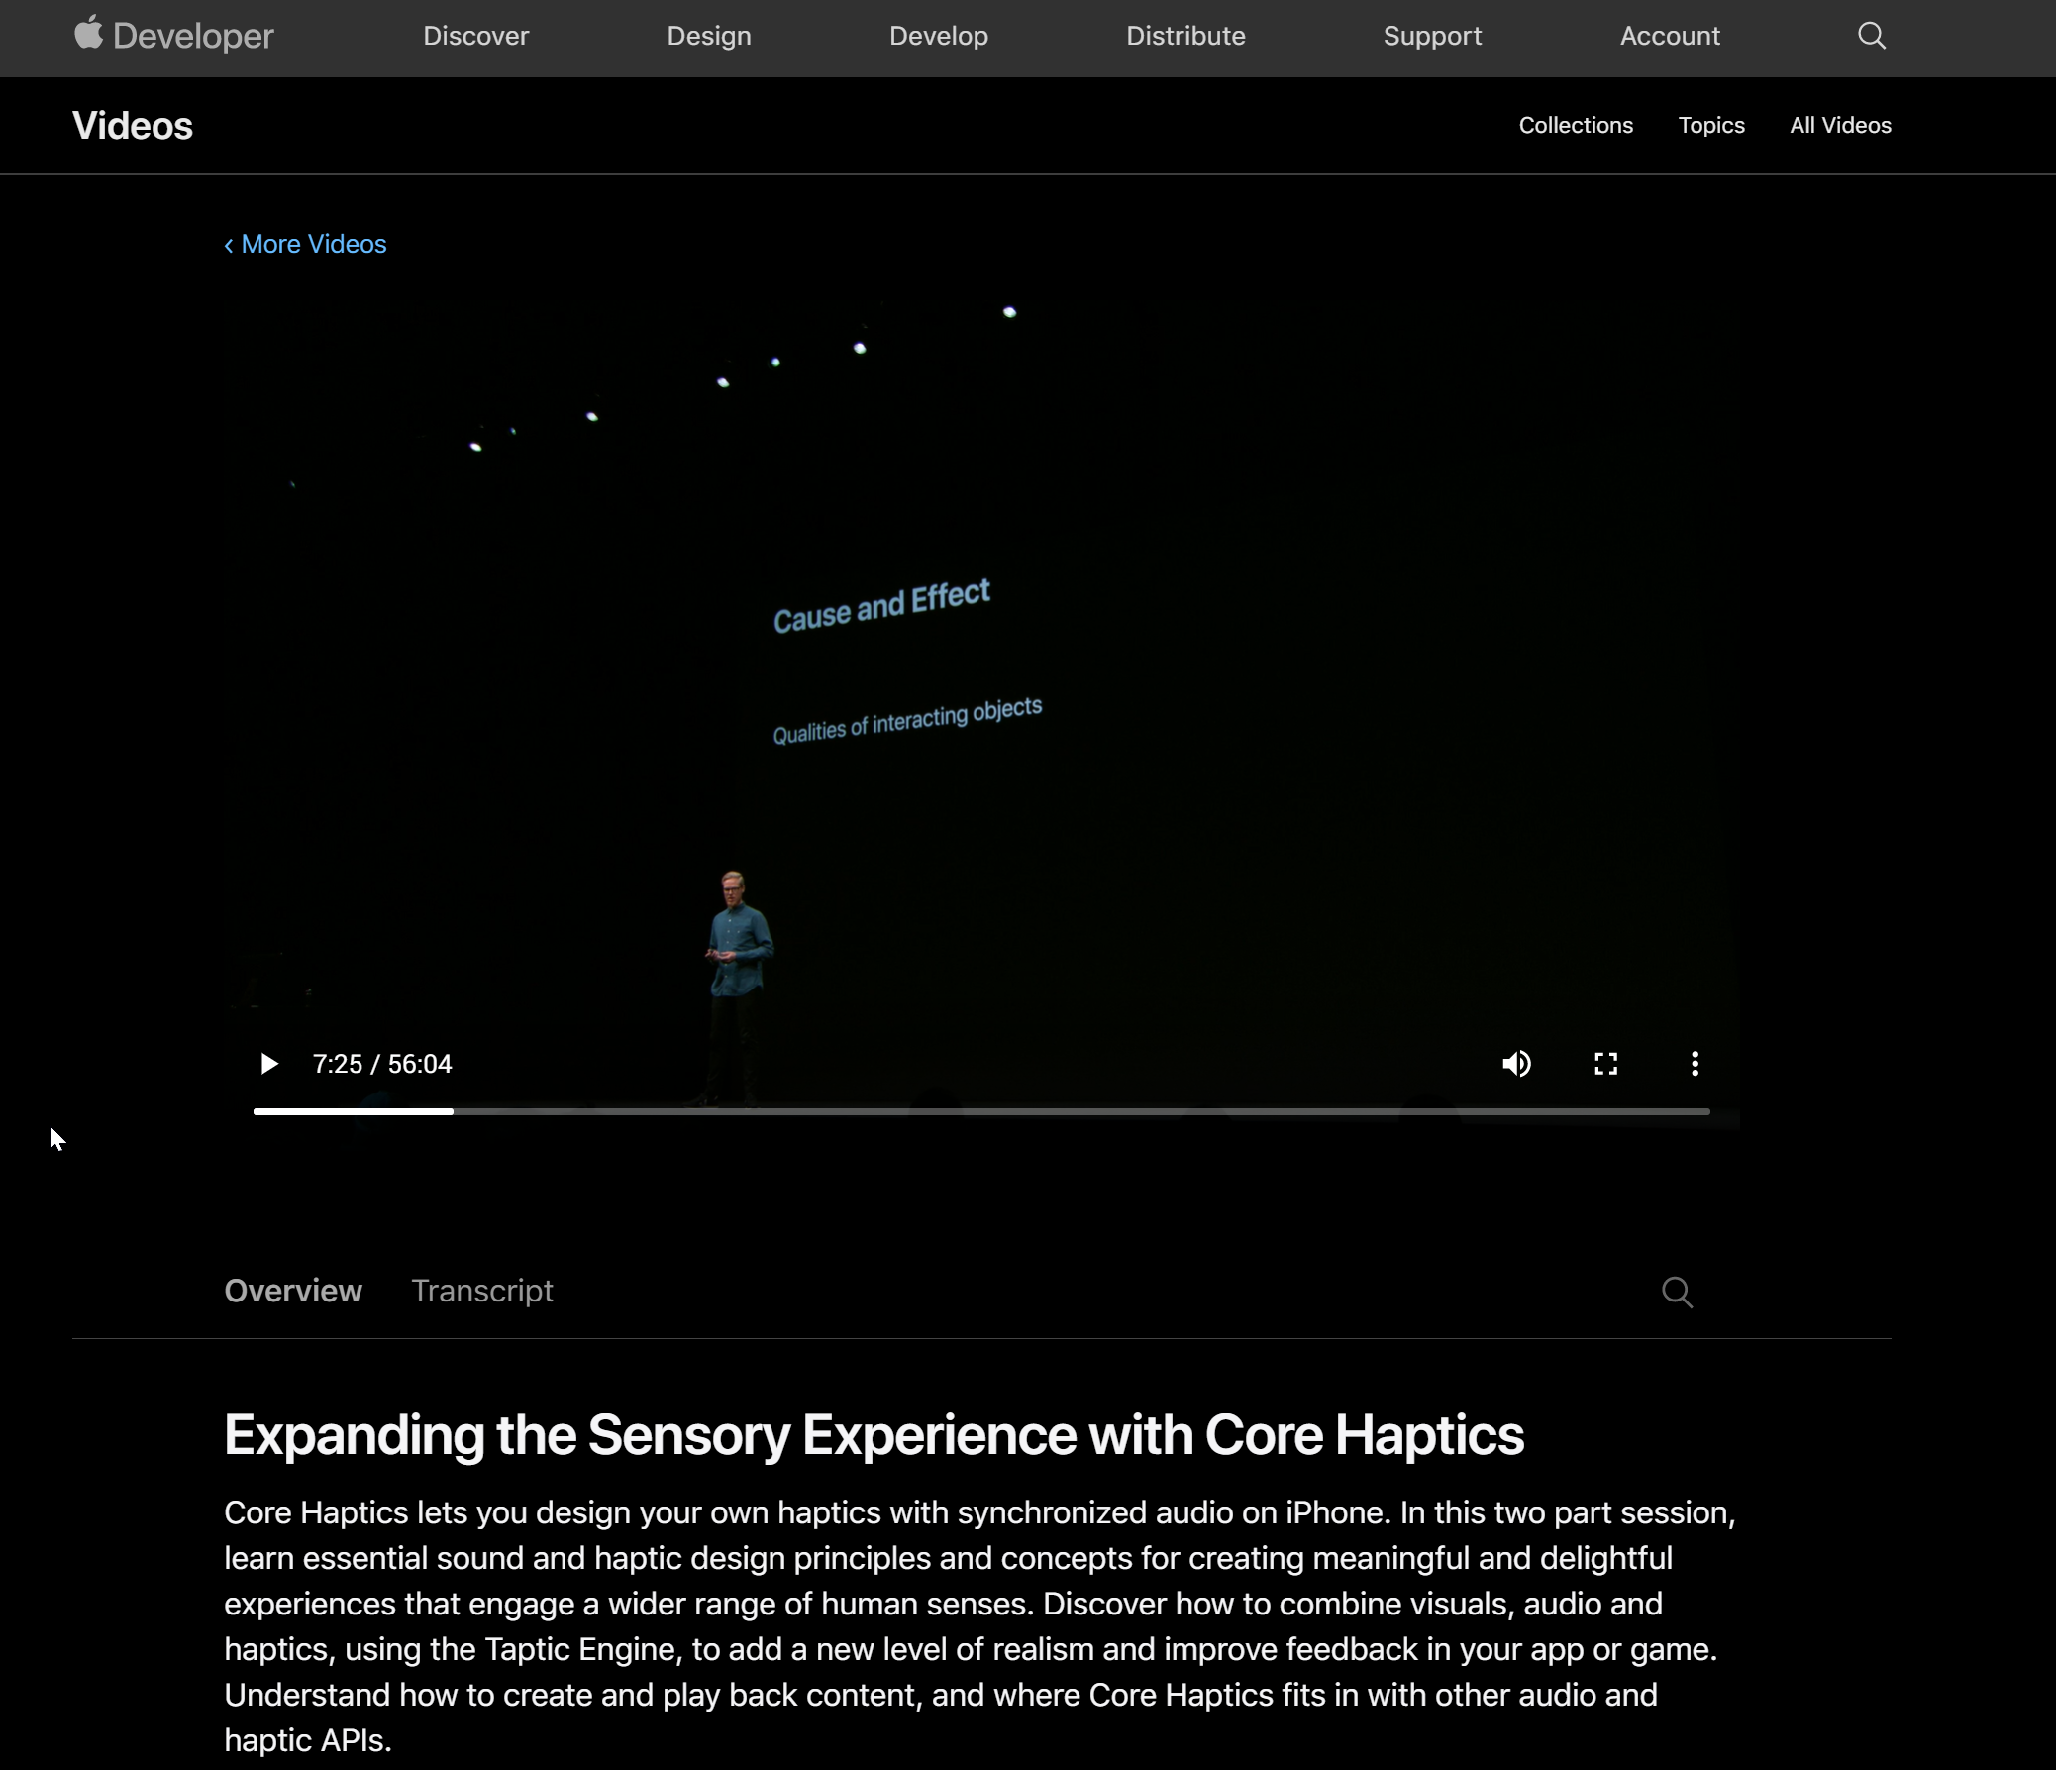
Slides here:
https://devstreaming-cdn.apple.com/videos/wwdc/2019/223ignoocw8xnuqx5di/223/223_expanding_the_sensory_experience_with_core_haptics.pdf?dl=1
Notes:
https://devstreaming-cdn.apple.com/videos/wwdc/2019/223ignoocw8xnuqx5di/223/223_expanding_the_sensory_experience_with_core_haptics.pdf?dl=1

Slide 3
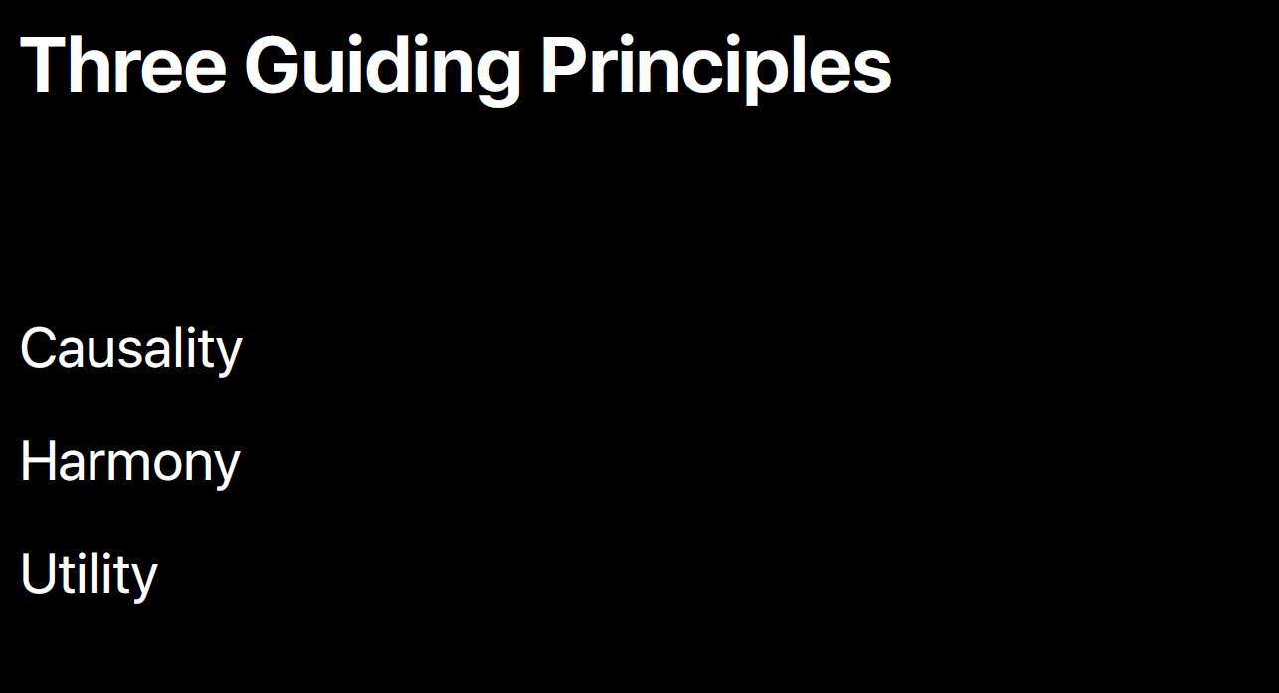

Slide 4
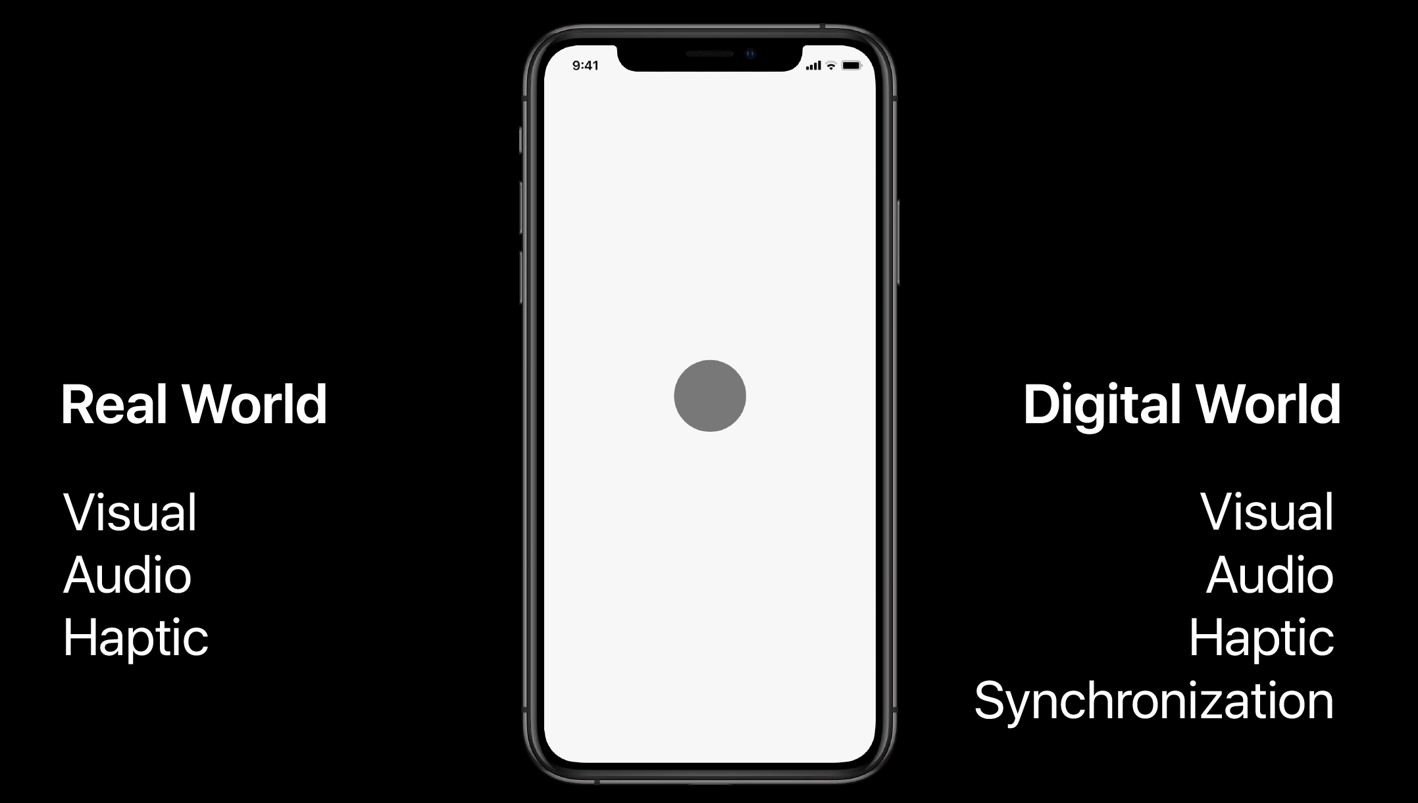

Slide 5


According to : https://microdcmotors.com/linear-resonant-actuator
Tactsuit uses LRAs

Slide 6
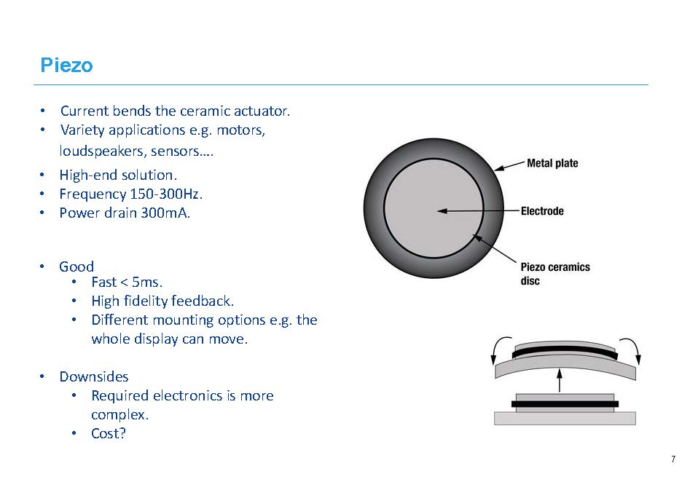
Notes:
https://www.nfpmotor.com/FAQ-tactile-actuator-technologies.html

Slide 7
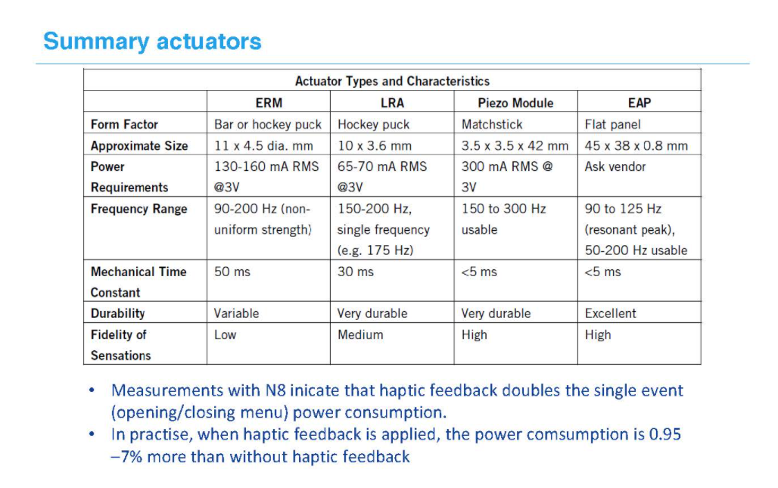
Notes:
https://www.nfpmotor.com/FAQ-tactile-actuator-technologies.html

Slide 8
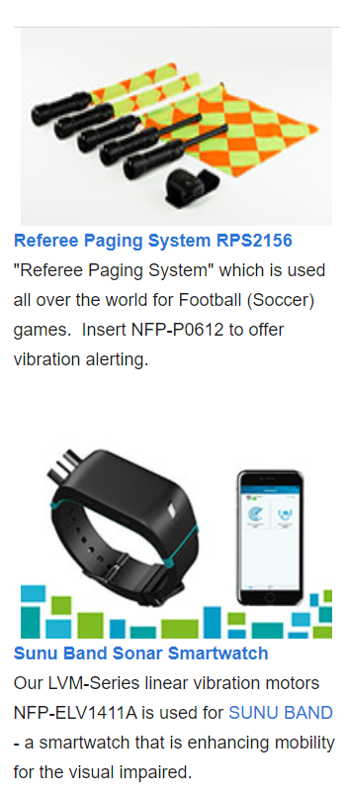
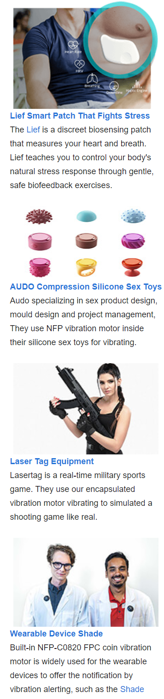


Slide 9
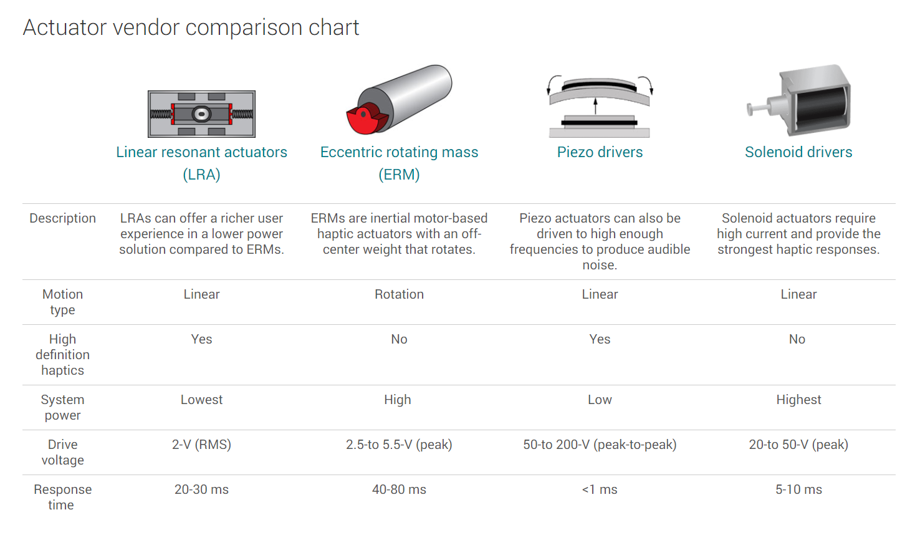
Notes:
https://www.ti.com/motor-drivers/actuator-drivers/overview.html

Slide 10
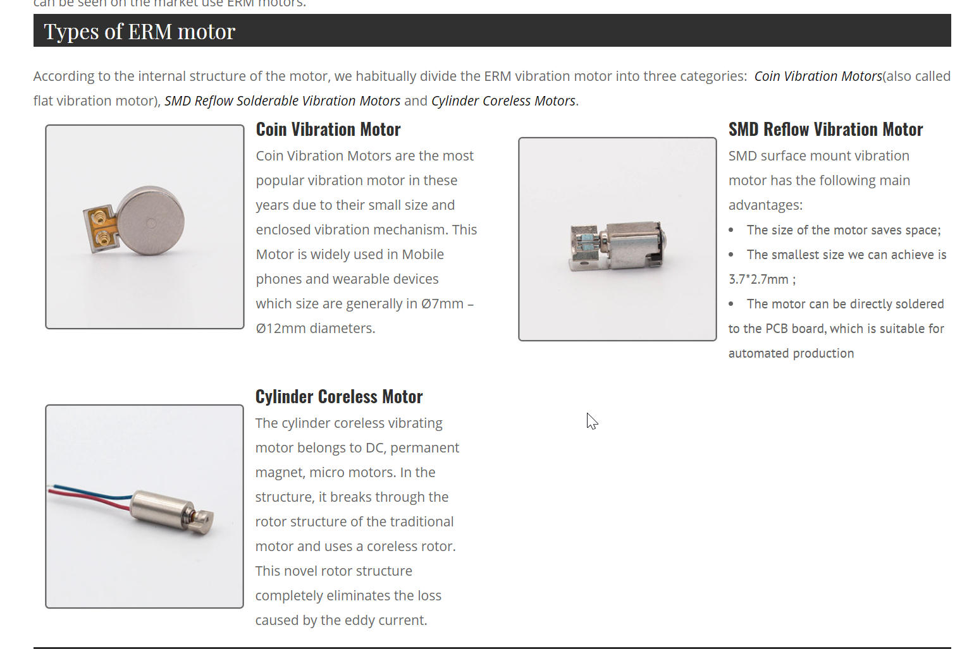

Slide 11
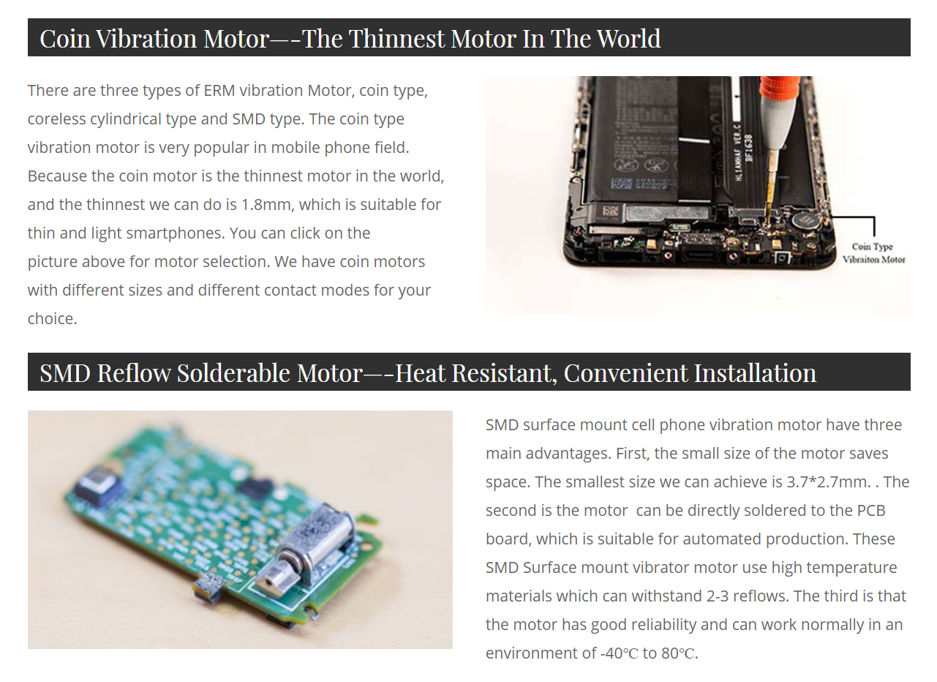
Notes:
https://www.vibrationmotors.com/vibration-motor-product-guide/cell-phone-vibration-motor/

Slide 12
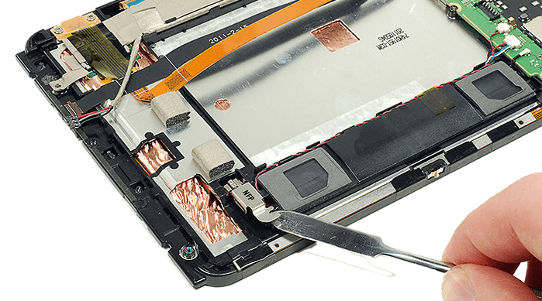
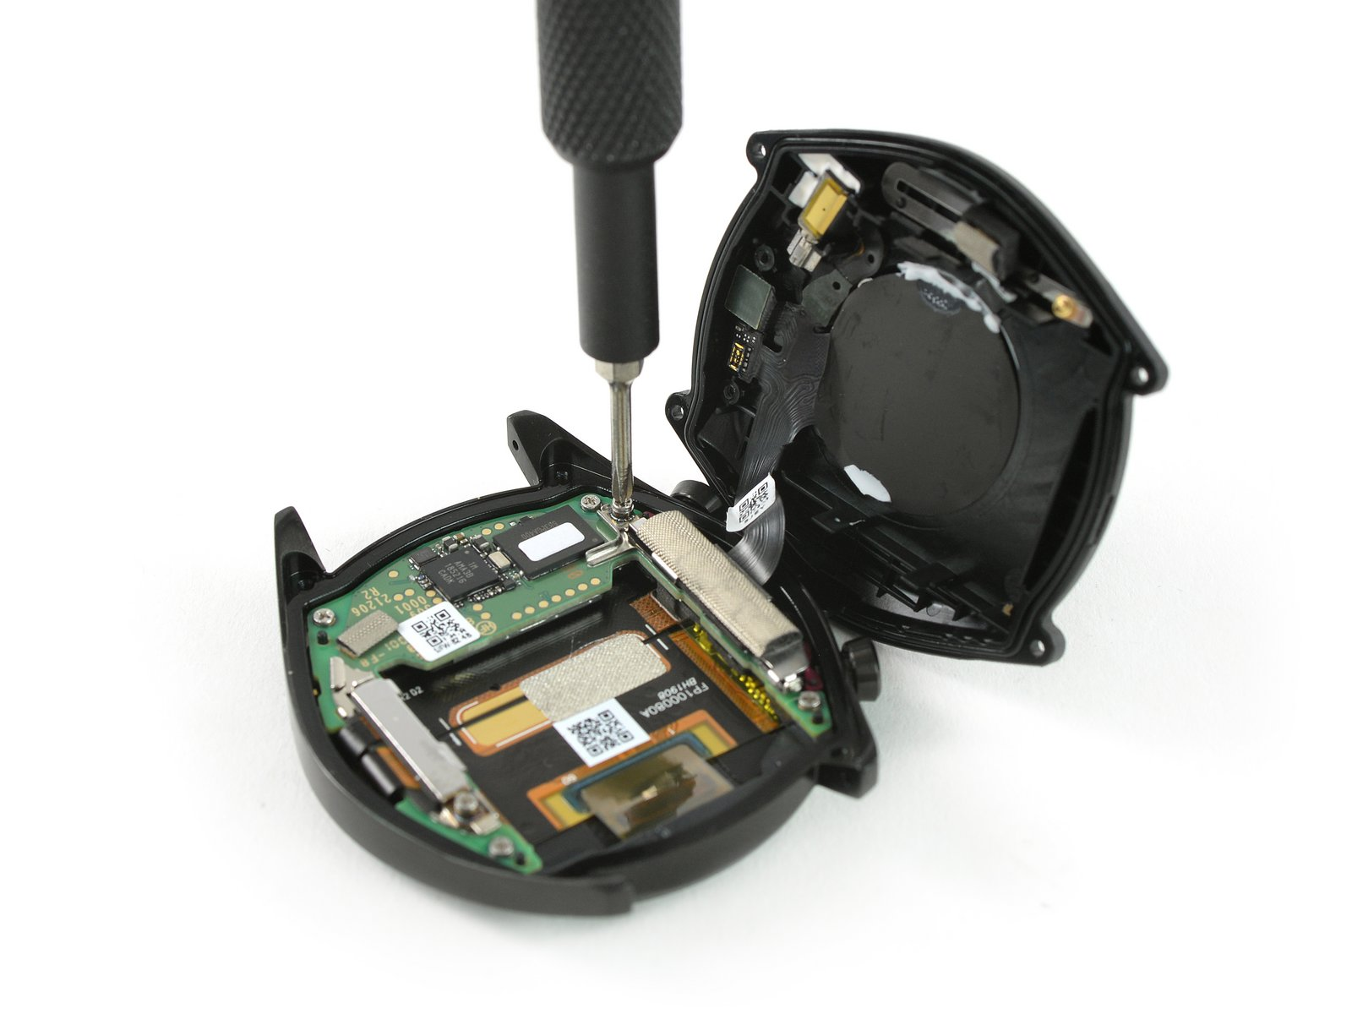

Slide 13
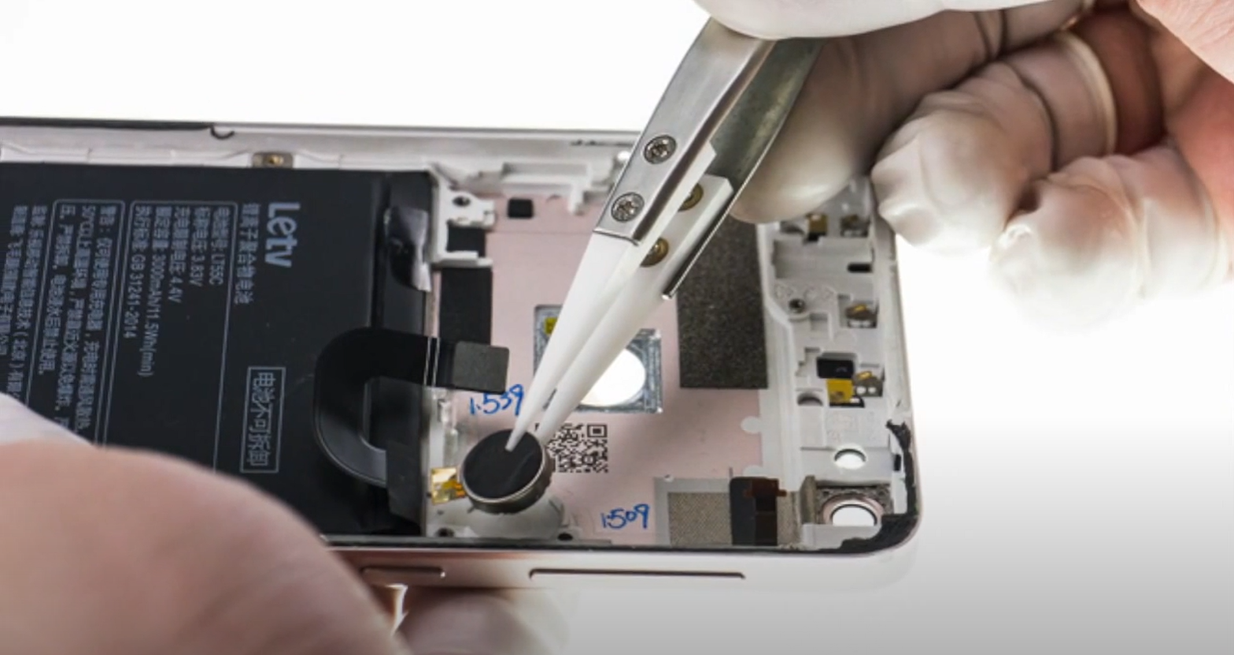
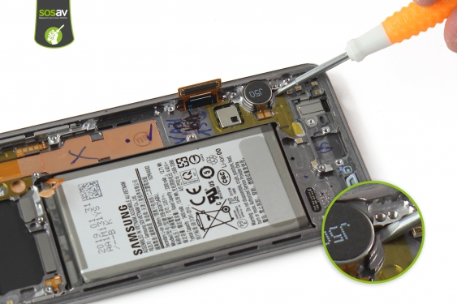
Cylindrical ERM
Cylindrical ERM
LRA
Coin ERM

Slide 14
Cylindrical ERM
Cylindrical ERM
LRA
Coin ERM

Slide 15
Notes:
https://www.sosav.com/guides/mobiles/samsung/galaxy-s10/vibrator/

Slide 16
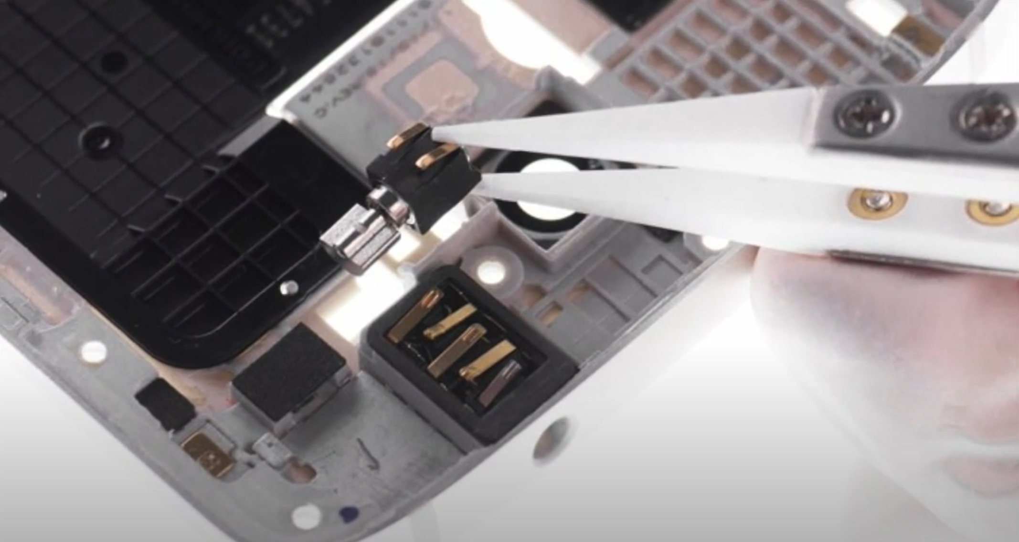
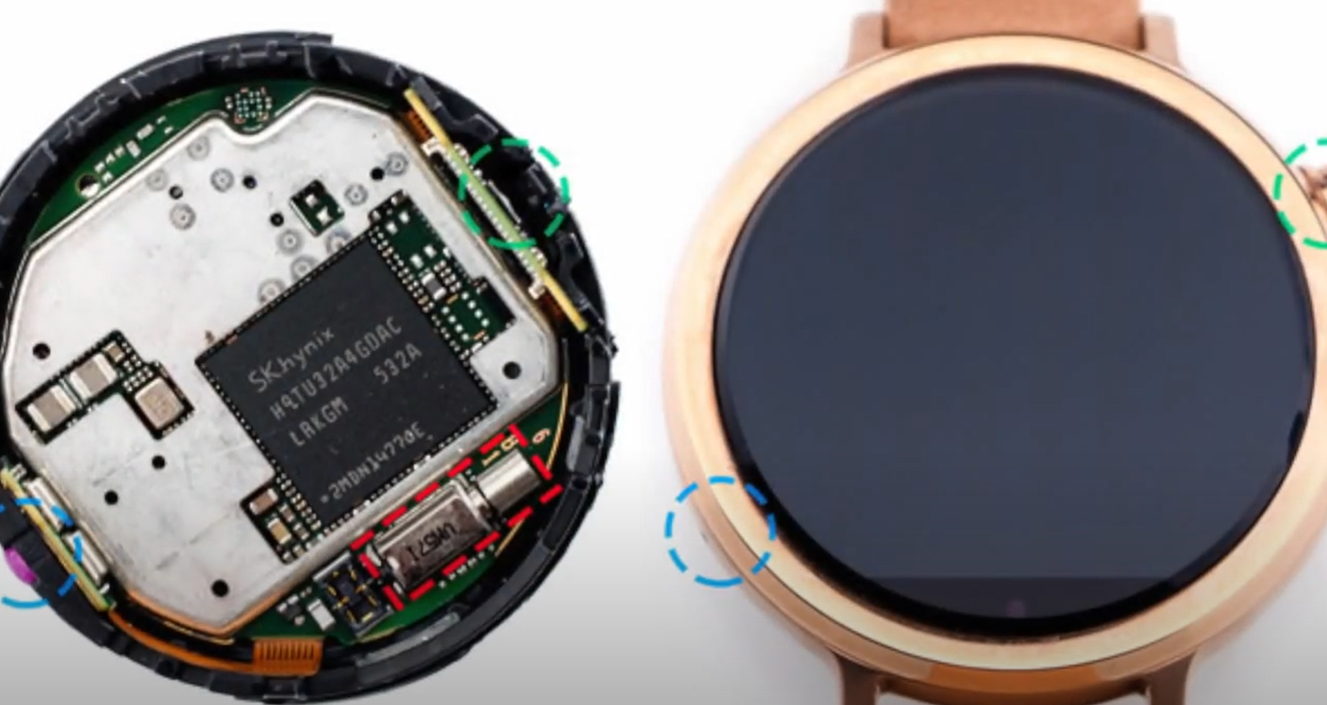
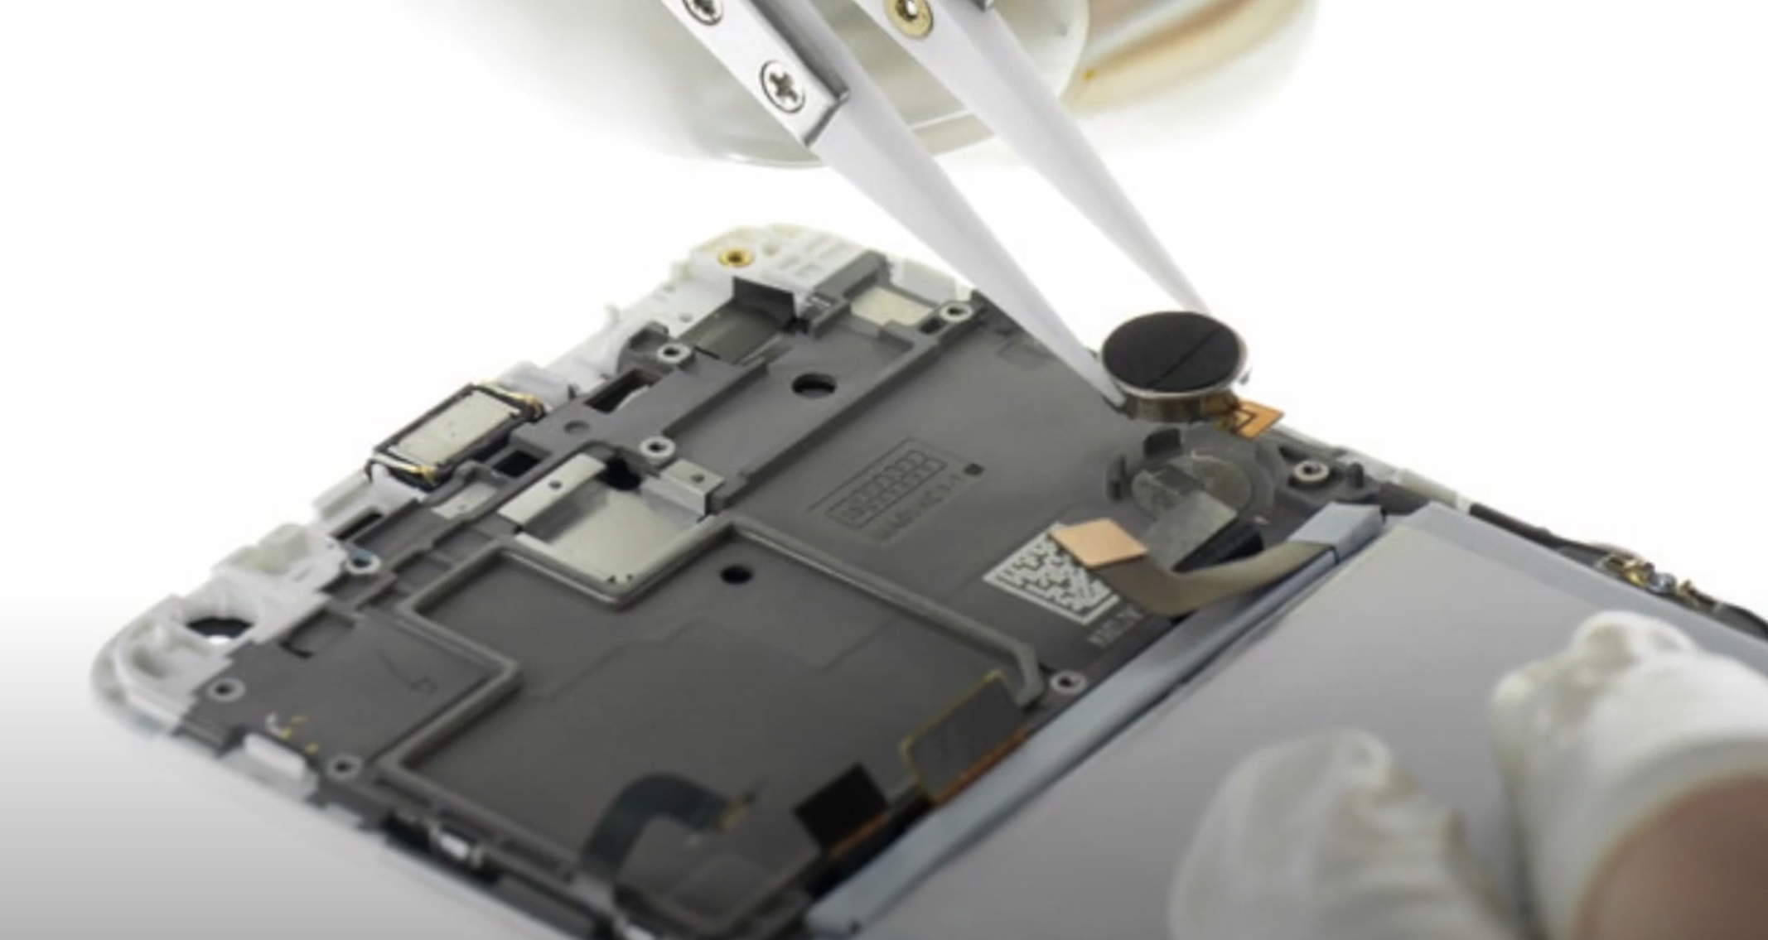
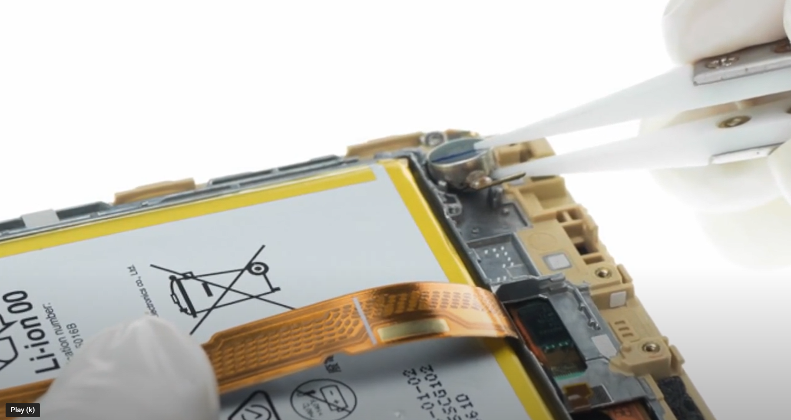
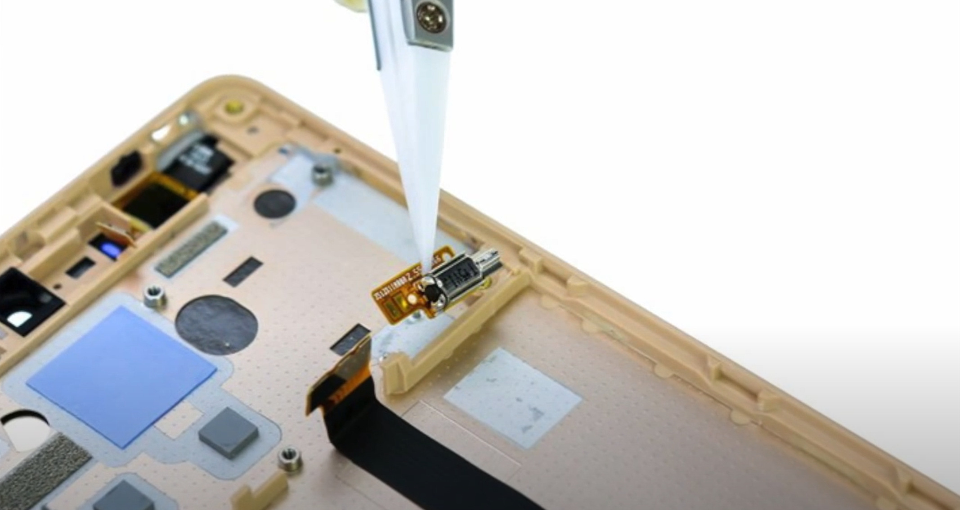
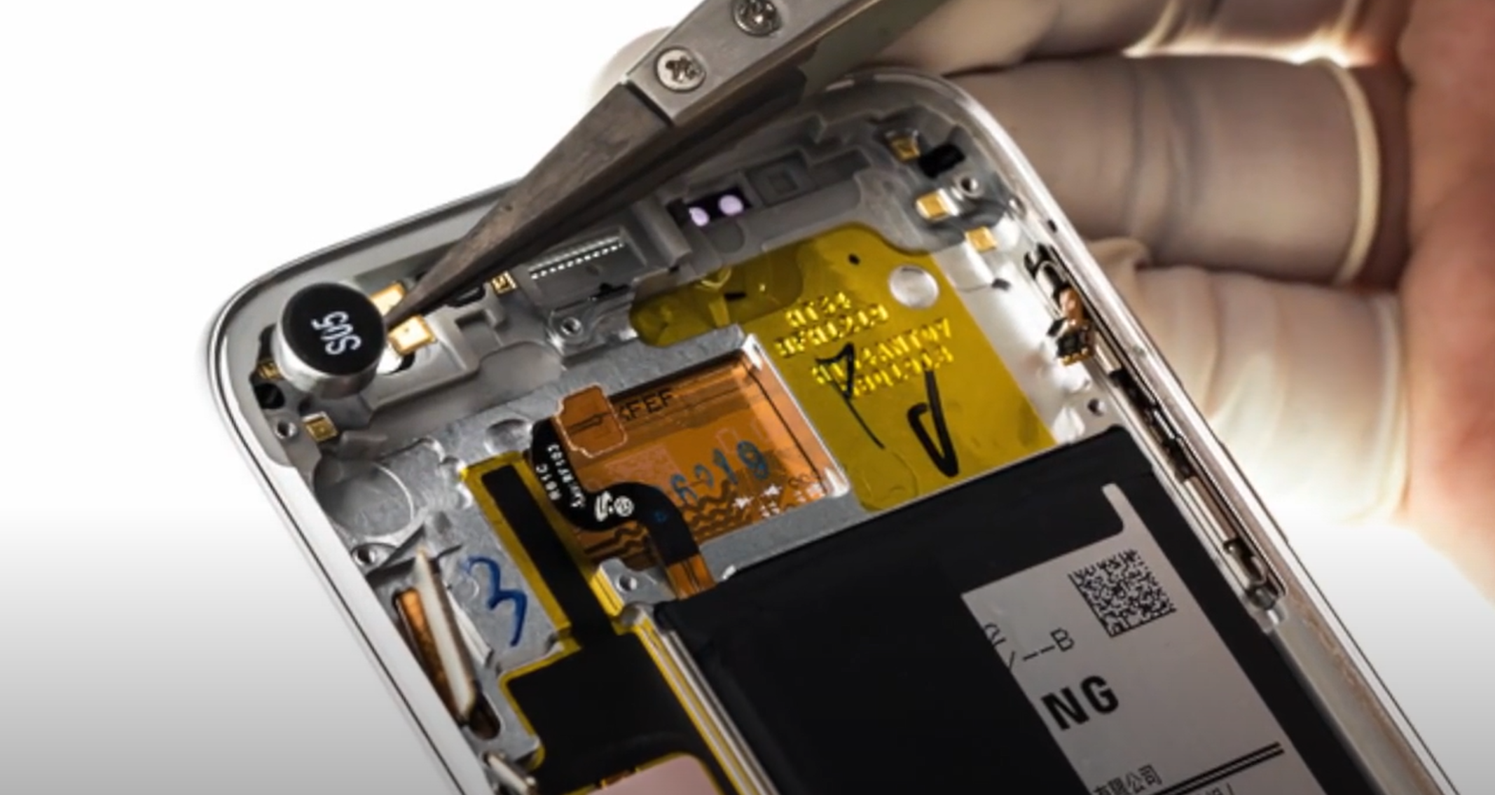
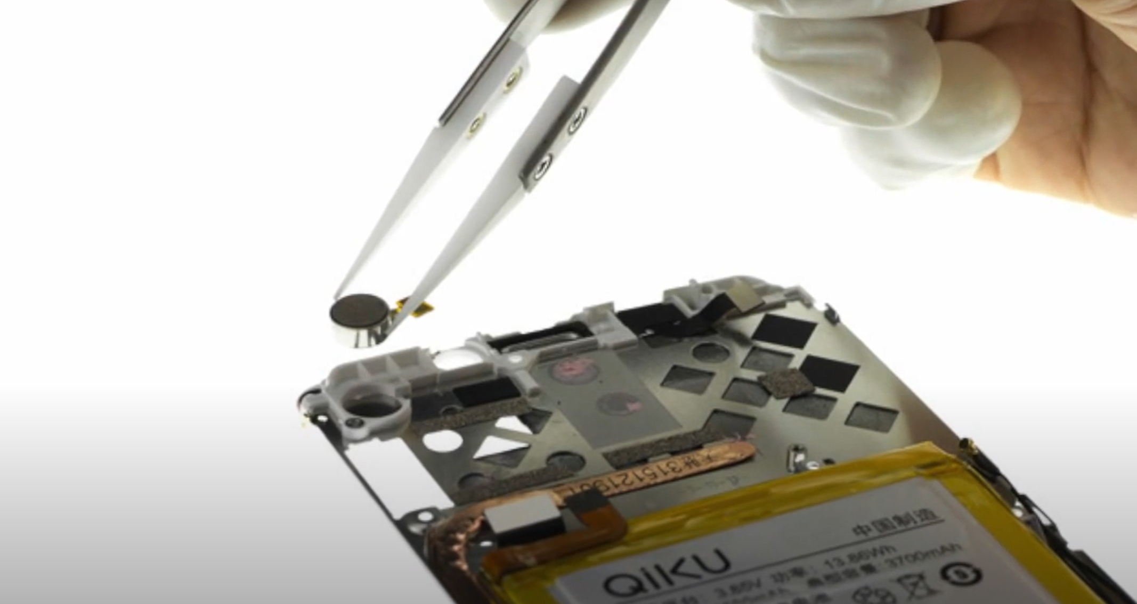
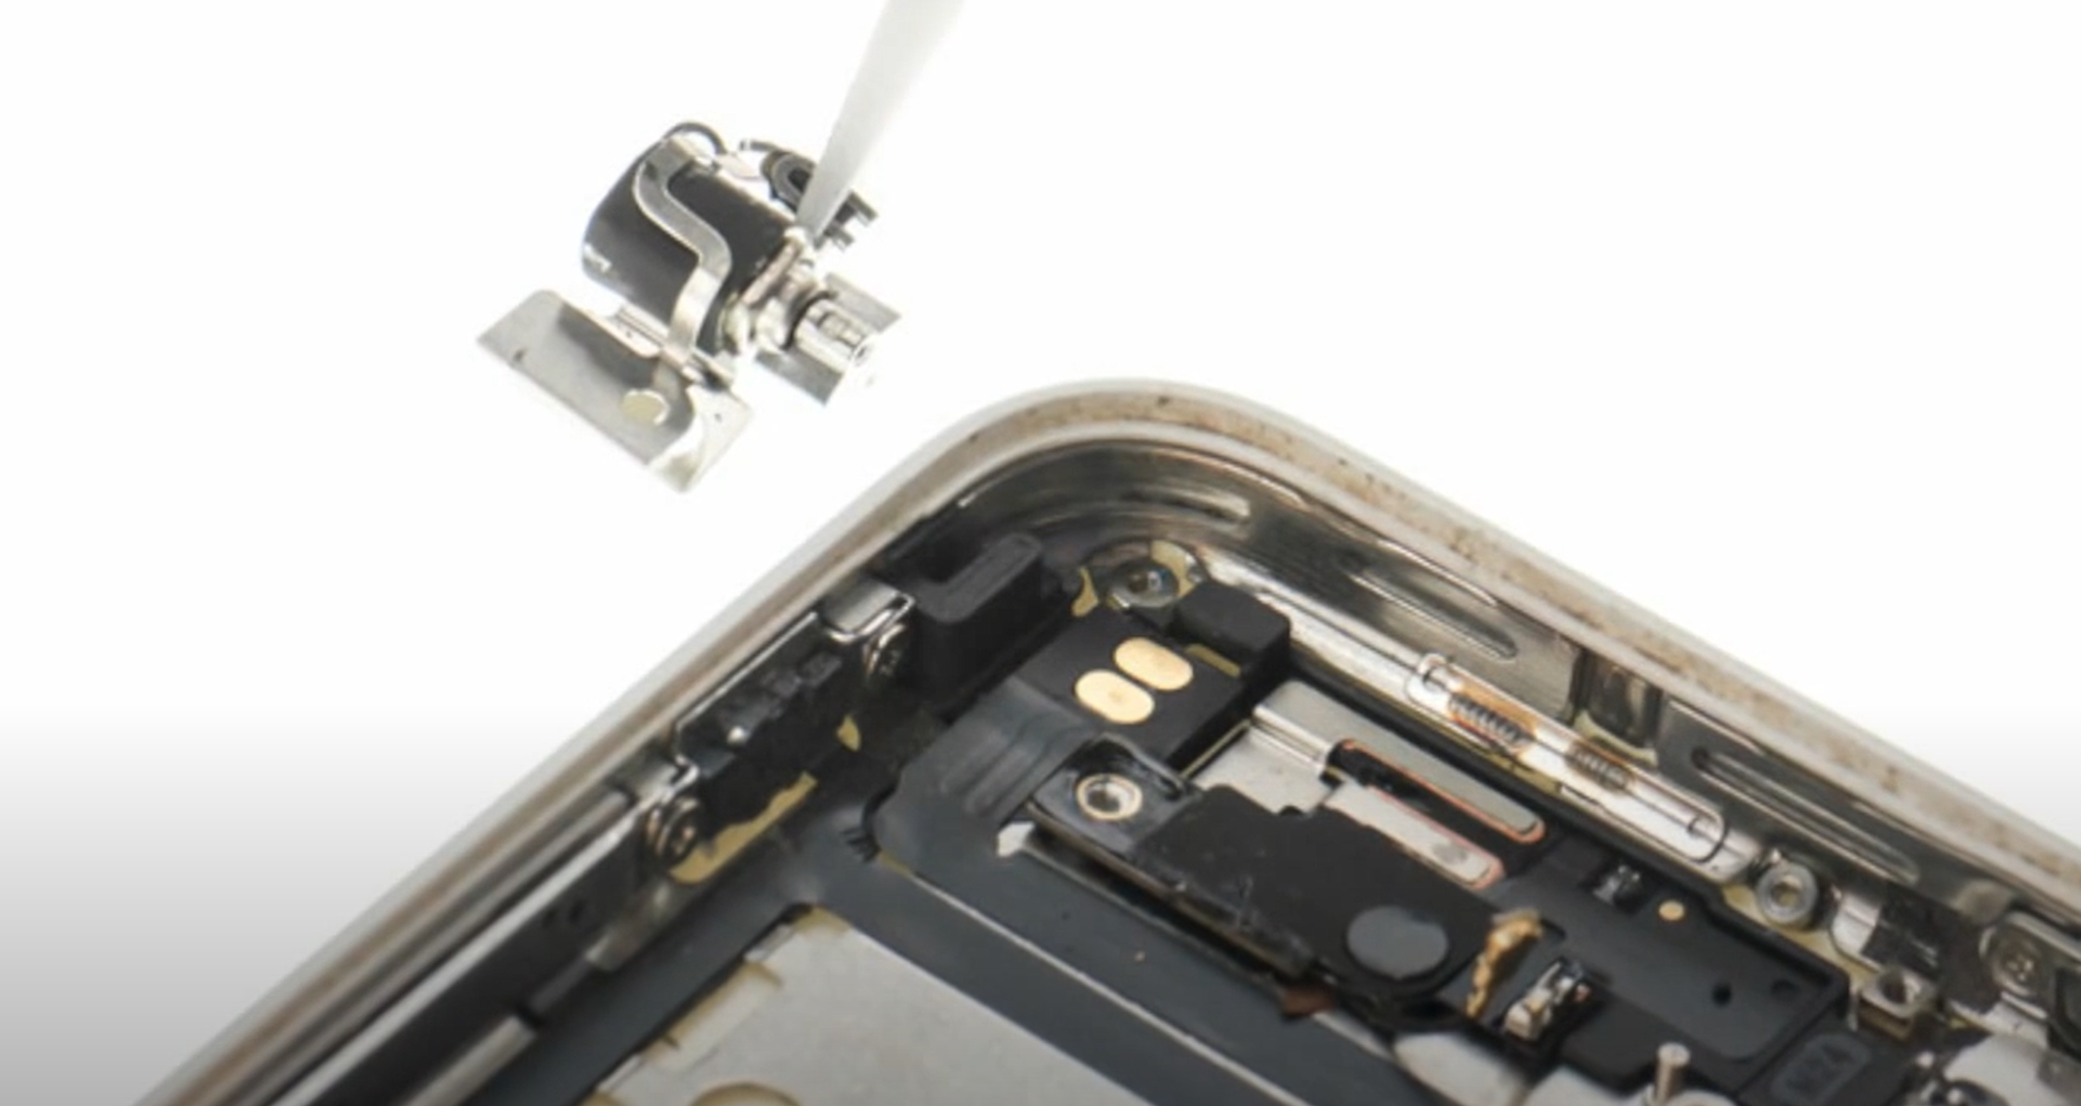
Notes:
From NFP motors: https://youtu.be/k1iTLqAtd0U

Slide 17
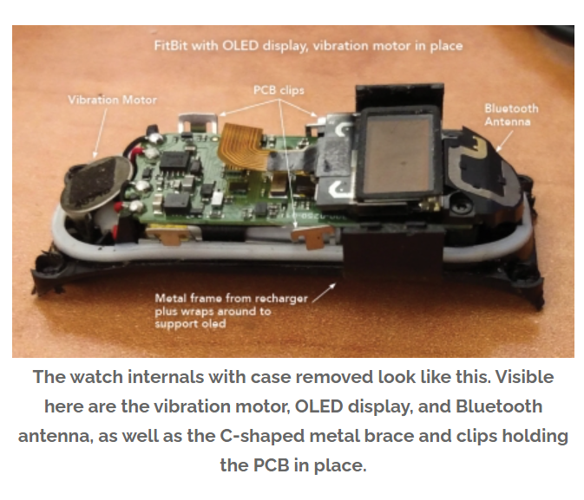
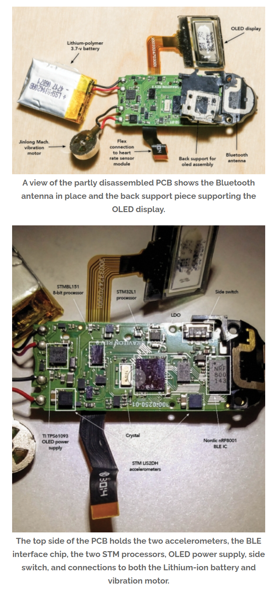
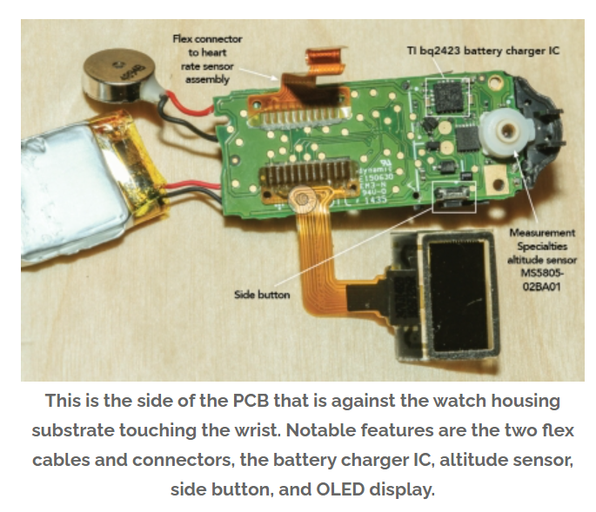

Slide 18
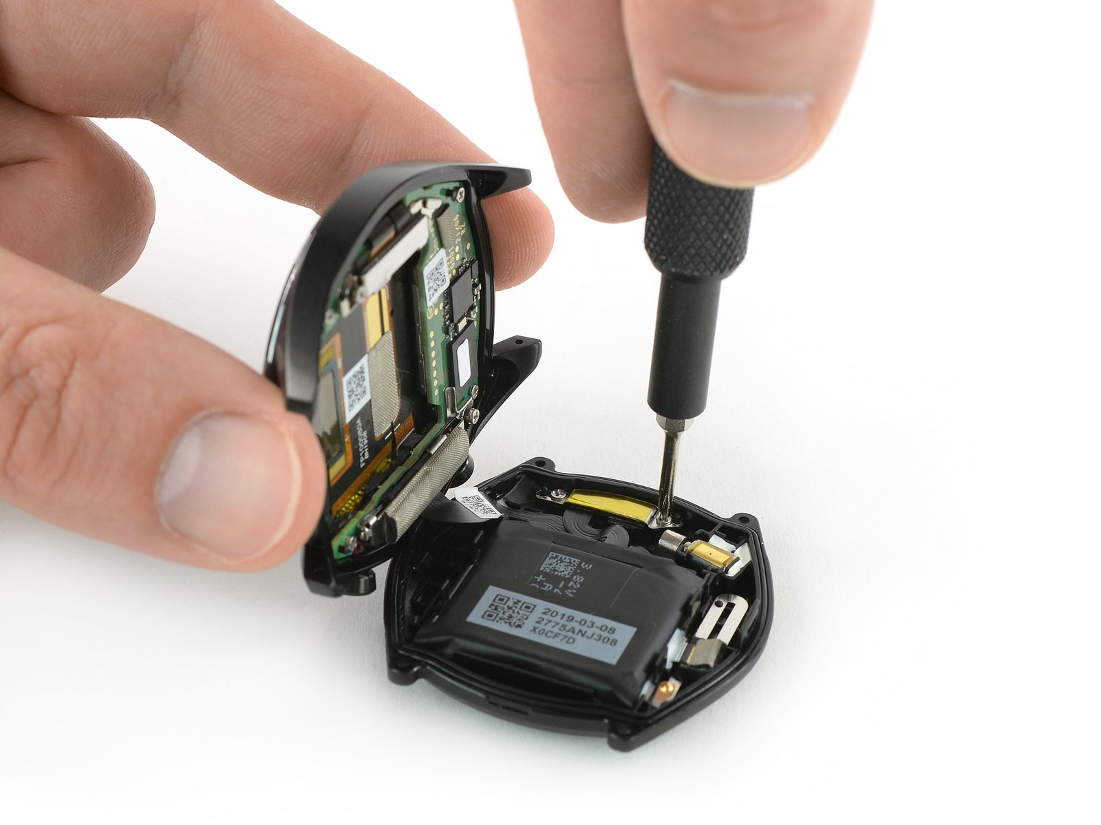
Notes:
https://www.ifixit.com/Guide/Huawei+Watch+GT+Repairability+Assessment/124018

Slide 19
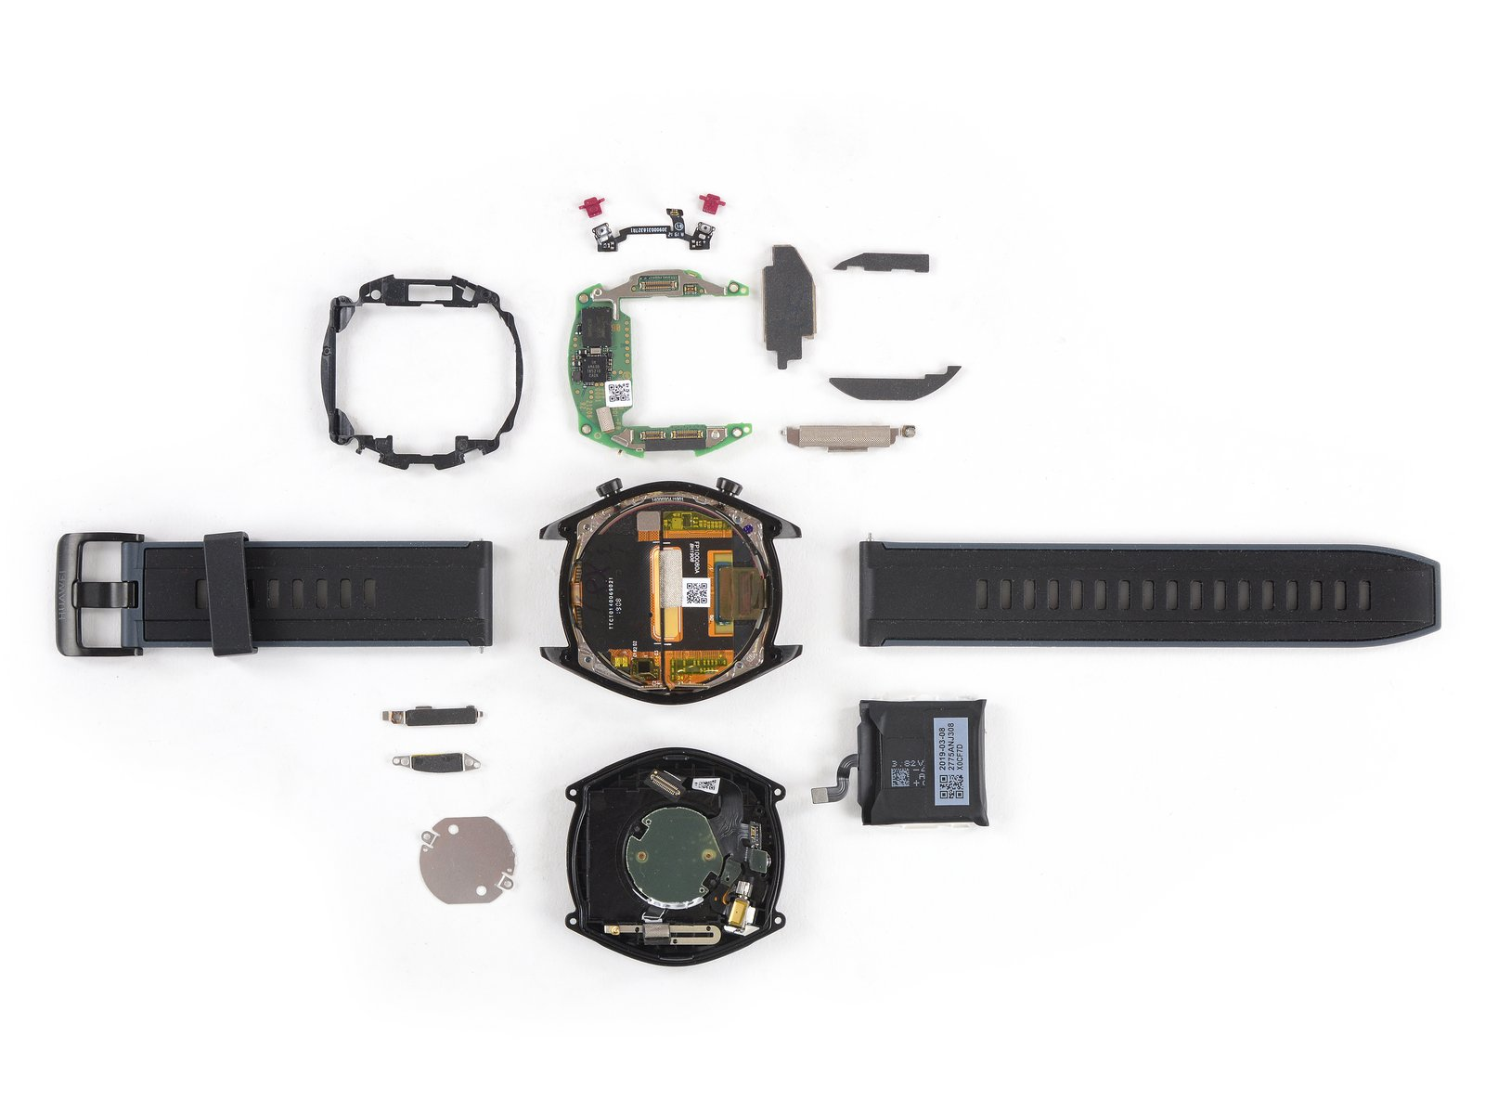
Notes:
https://www.ifixit.com/Guide/Huawei+Watch+GT+Repairability+Assessment/124018

Slide 20
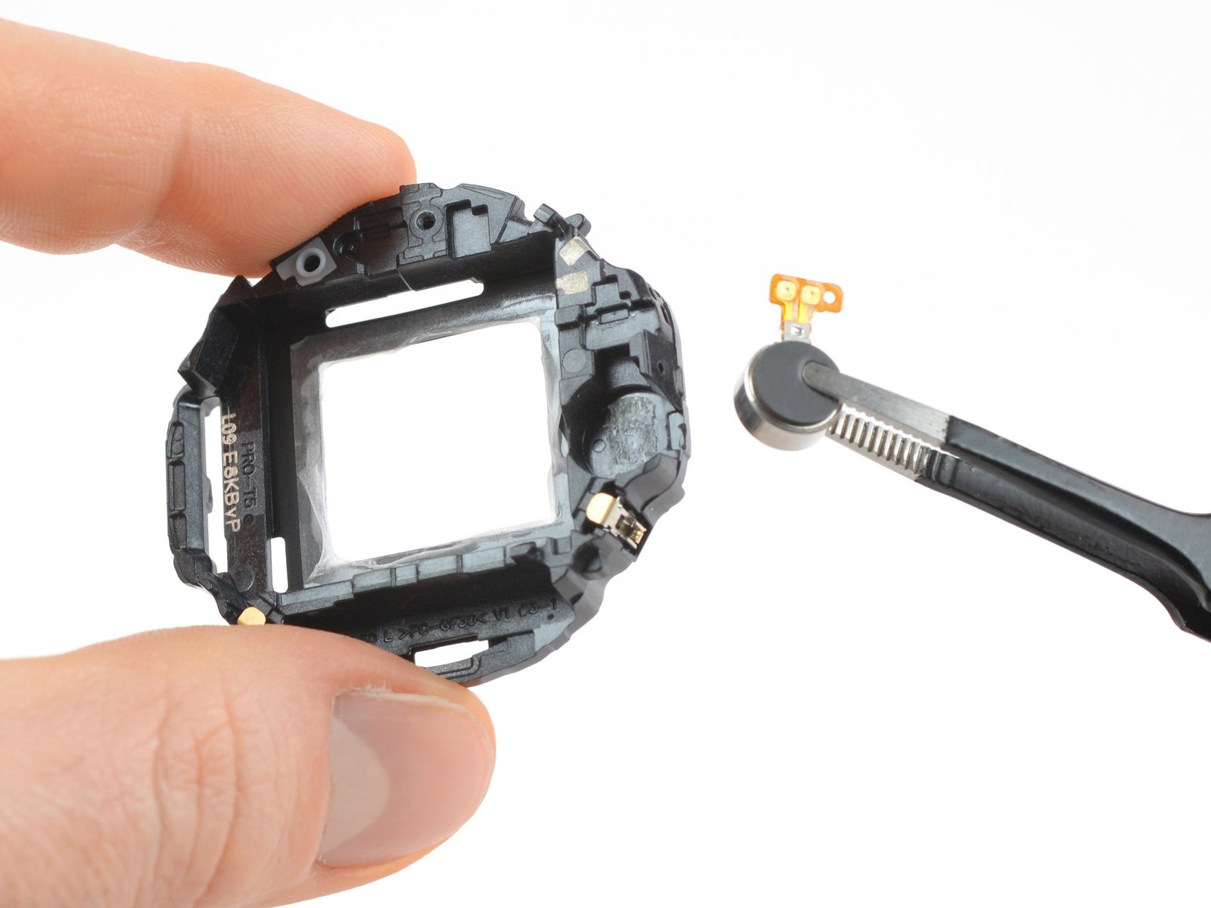
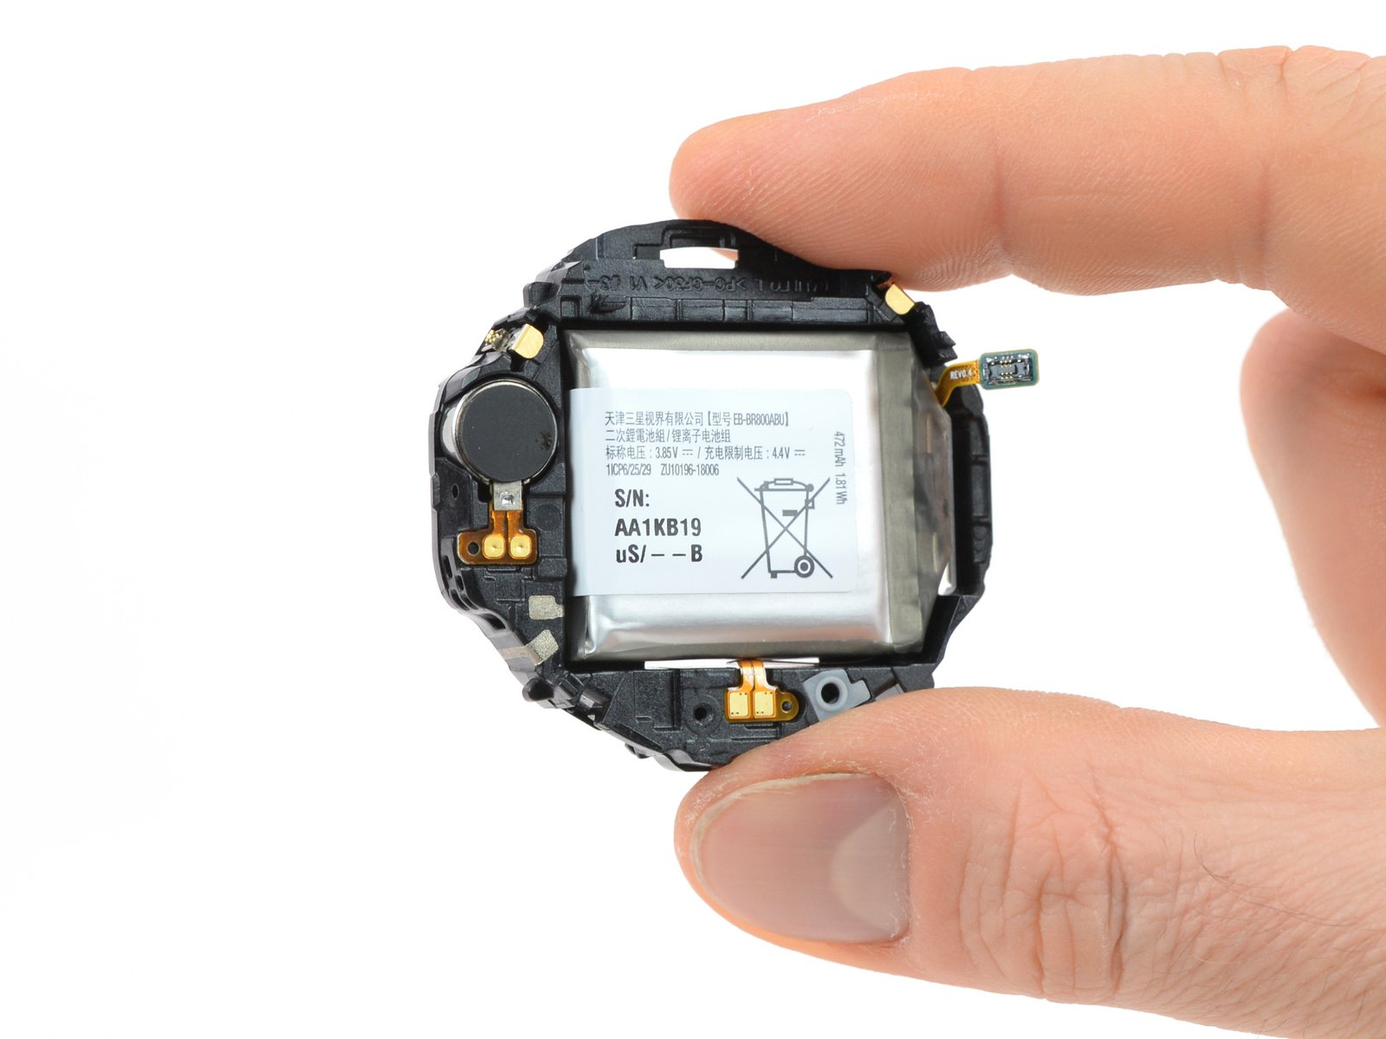
Notes:
https://www.ifixit.com/Teardown/Samsung+Galaxy+Watch+Teardown/117519

Slide 21
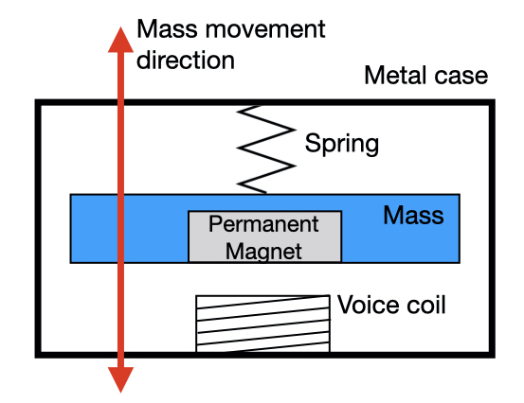
LRA
Notes:
https://ai.googleblog.com/2020/11/haptics-with-input-using-linear.html

Slide 22
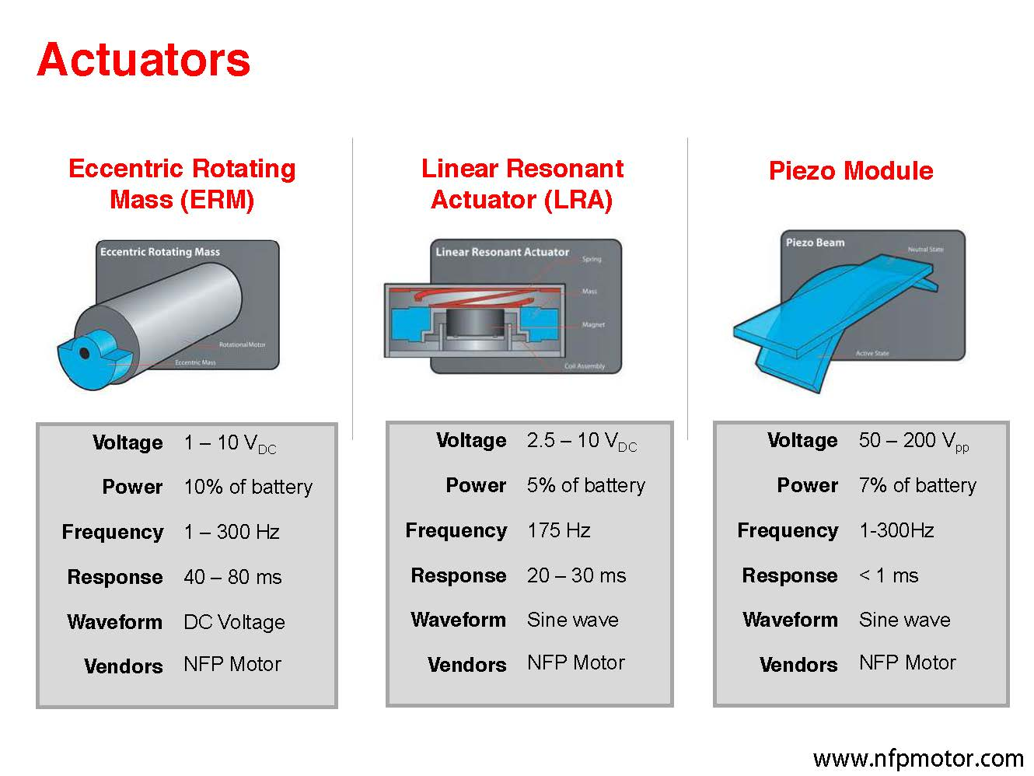
Notes:
https://www.nfpmotor.com/FAQ-the-final-solution-for-haptic-feedback-design.html

Slide 23
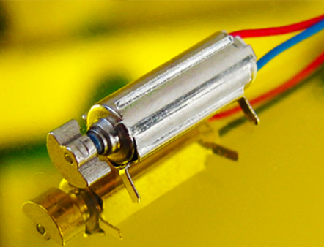
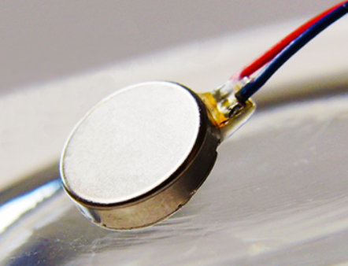
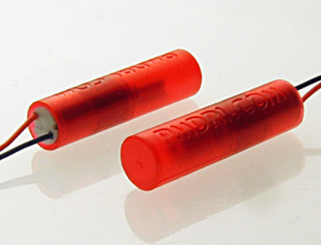
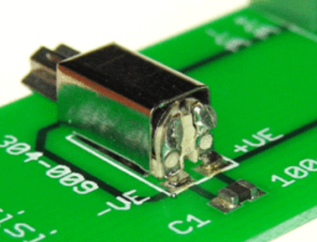
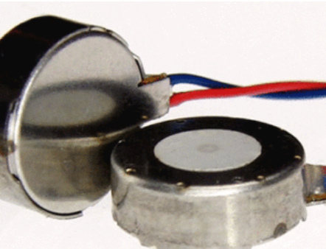

Slide 24
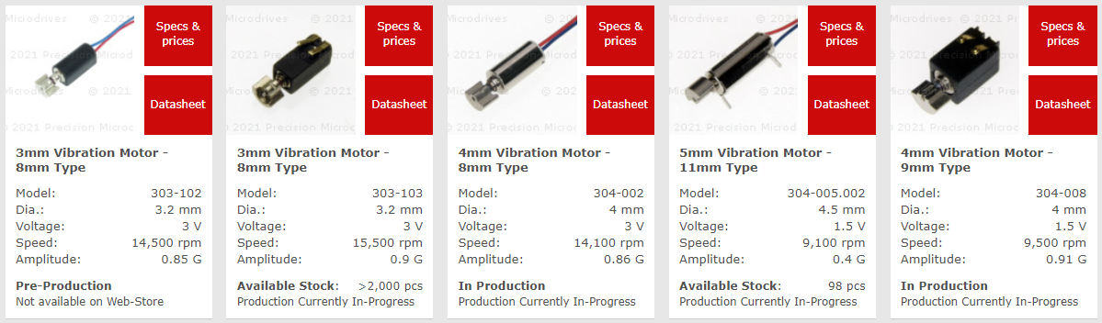
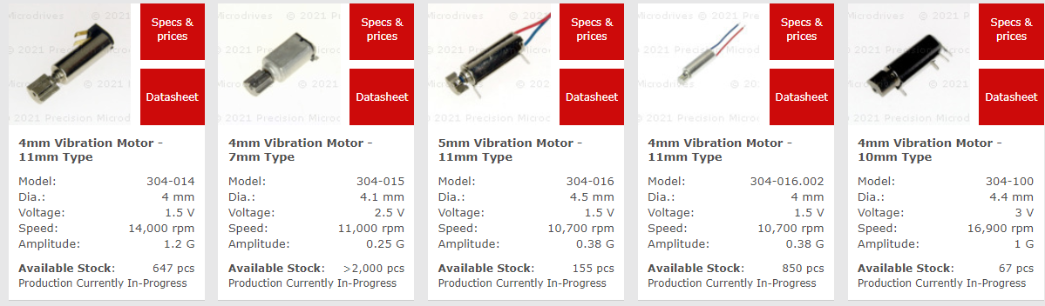
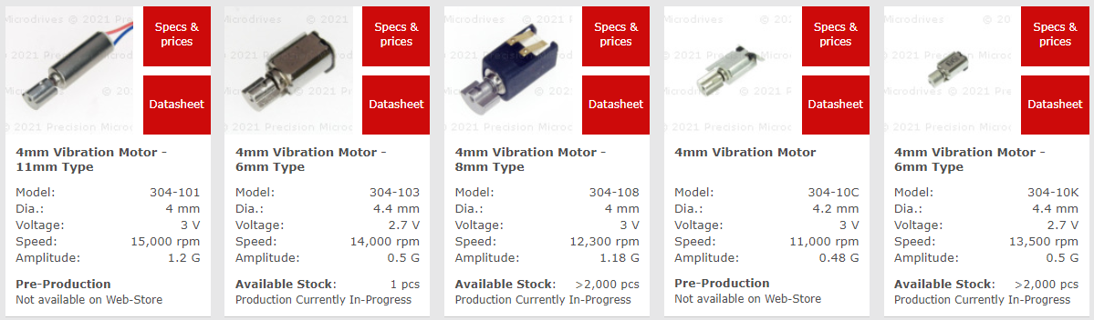
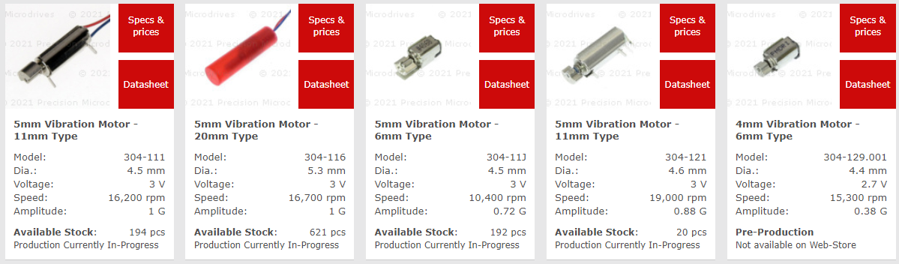
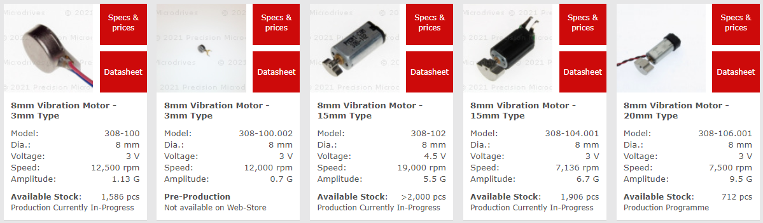
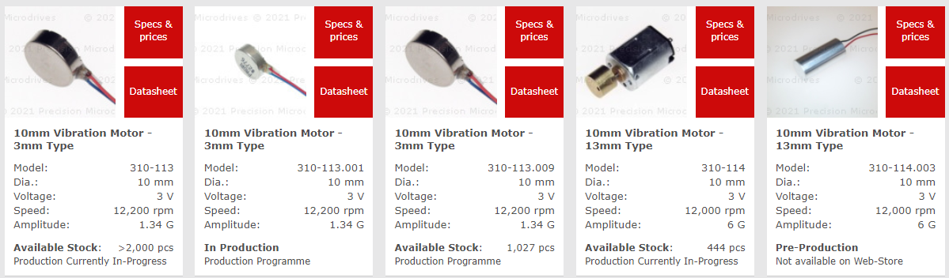

Slide 25
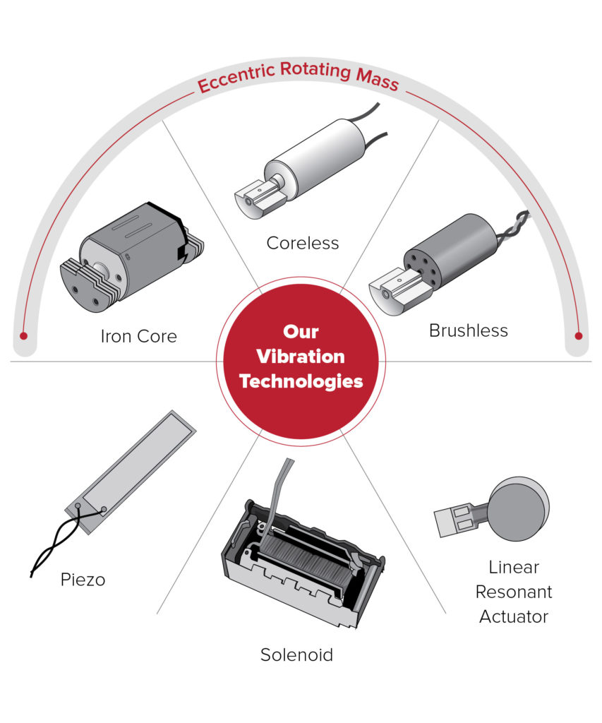
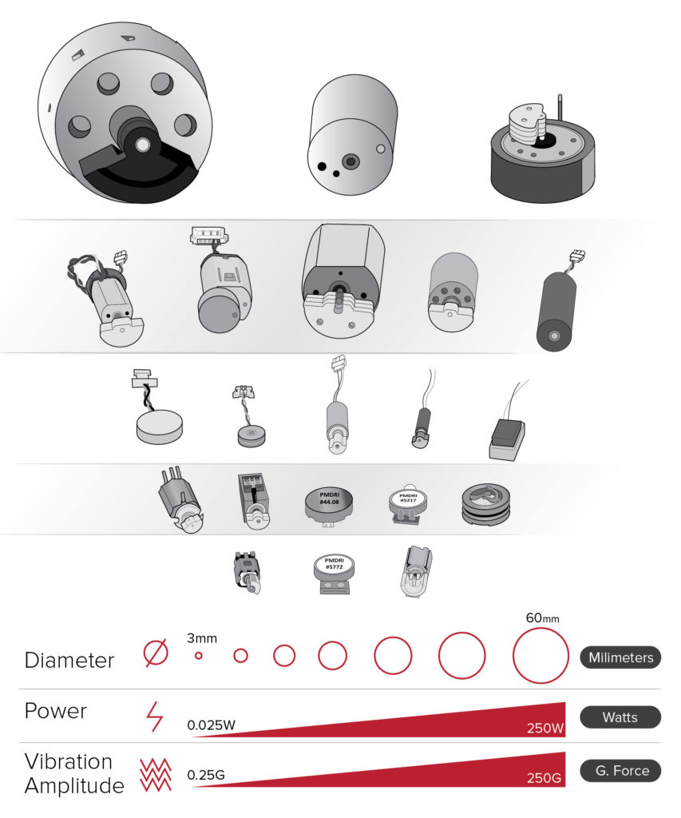
Notes:
https://products.precisionmicrodrives.com/vibrationmotors/

Slide 26
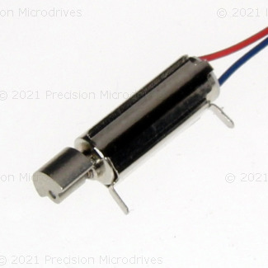
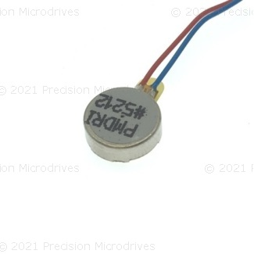
Body Diameter | Body Length | Eccentric Weight Radius | Eccentric Weight Length | Shaft Orientation | Operating Voltage | Vibration Speed | Typical Operating Current | Typical Amplitude

Slide 27
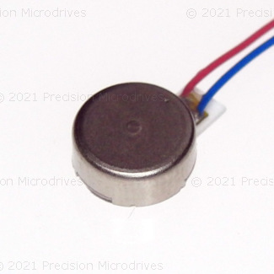
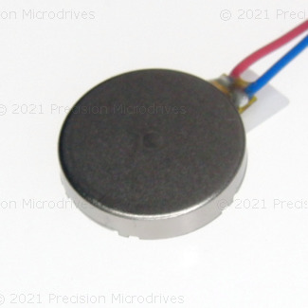


Slide 28






Example ERM Motor
8mm x 3mm
Example LRA Motor
8mm x 3mm

Slide 29
Example ERM Motor
8mm x 3mm
Example LRA
8mm x 3mm
Precision Microdrives: Model 308-100
Precision Microdrives: Model C08-00A

Slide 30






ERM Cylindrical / Pager
ERM COIN / Pancake
PCB Mounted
Encapsulated
PCB Mounted

Slide 31

Notes:
https://www.precisionmicrodrives.com/content/ab-028-vibration-motor-comparison-guide/

Slide 32


Vibration Amplitude:
Angular velocity ω
$$F=mrω^{2}$$
Eccentric mass m
Eccentric mass radius r

Slide 33


Notes:
https://www.nfpmotor.com/products-linear-resonant-actuators-lras.html

Slide 34

Notes:
https://www.nfpmotor.com/products-linear-resonant-actuators-lras.html

Slide 35


Notes:
https://www.precisionmicrodrives.com/vibration-motors/linear-resonant-actuators-lras/

Slide 36



Slide 37


Slide 38

Notes:
https://youtu.be/sRVvUkK0U80

Slide 39


https://components101.com/transistors/2n2222a-pinout-equivalent-datasheet
Notes:
https://components101.com/transistors/2n2222a-pinout-equivalent-datasheet

Slide 40


Slide 41


TO-92 Package
TO-220 Package

Slide 42

Notes:
https://circuitdigest.com/article/understanding-the-difference-between-bjt-and-mosfet-and-how-to-select-the-right-one-for-your-designs

Slide 43


Slide 44

Notes:
https://www.theengineeringprojects.com/2018/05/introduction-to-bjt-bipolar-junction-transistor.html

Slide 45



Notes:
https://components101.com/transistors/tip120-pinout-datasheet-equivalent

Slide 46







TO-92 Semiconductor Package
TO-220 semiconductor Package
Metal heatsink
NPN BJT
2N3904 40V 200mA
N-Channel MOSFET
2N7000 60V 200mA
NPN BJT
TIP120 Darlington Power Transistor 60V, 5A
N-Channel MOSFET
IRLB8721 Power MOSFET 30V, 62A

Slide 47



basic Wiring (WRONG)
Transistor Wiring
Transistor With Protection Circuitry
Use 3.3V supply for 3V motor
Incorrect!
Best!
Better!
This wiring is incorrect! The GPIO pins are intended to supply 20-40mA maximum. The ERM motor requires 75mA (and up to 120mA for startup current)
1KΩ to limit base current into transistor
Collector pin
Emitter pin
1N4001 Diode
NPN Transistor: 2N2222
0.1 µF Capacitor
The “flyback” diode handles the sudden voltage spike created by the motor when its supply current is turned off. The capacitor also helps smooth voltage spikes created by the spinning motor.
NPN Transistor: 2N2222

Slide 48



3.3V Supply Wiring
5V Supply Wiring

Slide 50



Slide 51



Slide 52



5V
Collector
Emitter
Base
GND
Microcontroller Output Pin

Slide 53
Microcontroller
5V
ERM Vibromotor
Rated current 75mA. Starting current: up to ~120mA.
Microcontroller Output Pin
Maximum current output: 40mA (but safe continuous range 20-30mA)
Base Resistor
1kΩ
Collector pin
Transistor orientation
Transistor text label facing us
(round part facing away)
Base pin
Emitter pin
Wrong direction!
GND

Slide 54

Pictorial Diagram
Circuit Diagram
Microcontroller
5V
ERM Vibromotor
Rated current 75mA. Starting current: up to ~120mA.
Microcontroller Output Pin
Maximum current output: 40mA (but safe continuous range 20-30mA)
Base Resistor
1kΩ
Collector pin
Transistor orientation
Transistor text label facing us
(round part facing away)
Base pin
Emitter pin
Wrong direction!
GND

Slide 55
Pictorial Diagram
Circuit Diagram
Microcontroller
GND
Base Resistor
1kΩ
Emitter pin
Base pin
Transistor orientation
Transistor text label facing us
(round part facing away)
Microcontroller Output Pin
Maximum current output: 40mA (but safe continuous range 20-30mA)
Collector pin
ERM Vibromotor
Rated current 75mA. Starting current: up to ~120mA.
5V

Slide 56
Pictorial Diagram
Circuit Diagram
Microcontroller
Microcontroller
GND
Base Resistor
1kΩ
Output Pin
Maximum current output: 40mA (but safe continuous range ~20mA)
Emitter pin
Transistor orientation
Transistor text label facing us
(round part facing away)
Collector pin
Base pin
Base pin
Emitter pin
Collector pin
ERM Vibromotor
Rated current 75mA. Starting current: up to ~120mA.
5V or 3.3V

Slide 57

Notes:
http://www.learningaboutelectronics.com/Articles/Vibration-motor-circuit.php

Slide 58


Slide 59

Notes:
https://www.cs.umb.edu/cs341/Lab08/index.html

Slide 60
This is better
This is best
Don’t do this

